Slide 1


CMR TECHNICAL CAMPUS
UGC(Autonomous)
Kandlakoya,Medchal Road,Hyd-501 401 Department of Computer Science Engineering
Mini Project On
SENTIMENTAL ANALYSIS USING MACHINE LEARNING WITH MULTIPLE MODALITIES
BATCH NO : 17
Project Guide: BATCH MEMBERS:
Ms. Raheem Unnisa 217R1A0590 G SRAVIKA REDDY
Assistant Professor, CSE Department 217R1A0586 E SAI KUMAR
217R1A0587 G BHAVISH REDDY
Project Coordinator:
Dr. J. Narasimharao
Associate Professor, CSE Department

Slide 2
CONTENTS
Abstract
Existing System
Disadvantages
Proposed System
Advantages
System Requirements
Novelty of Project
System Architecture
UML Diagrams
Sample Code
Results
Conclusion
Future Scope
References

Slide 3
ABSTRACT
Sentiment analysis has evolved significantly with the rise of digital communication, where textual content alone often fails to capture the full spectrum of user emotions.
This project introduces a novel approach to sentiment analysis by incorporating multiple modalities—text, images, and audio—using advanced machine learning techniques.
By combining these diverse data sources, our approach offers a more nuanced understanding of sentiment, addressing the limitations of traditional unimodal methods.
We demonstrate the effectiveness of our multimodal model through comprehensive experiments on a diverse dataset of social media posts, product reviews, and multimedia content, achieving notable improvements in sentiment classification accuracy.
This approach not only enhances the depth of sentiment analysis but also paves the way for future advancements in affective computing, providing richer insights into user emotions and opinions across various digital platforms.

Slide 4
EXISTING SYSTEM
Existing systems for sentiment analysis using machine learning across multiple modalities have made significant strides in enhancing the understanding of sentiment by integrating various types of data.
VisualSent advances multimodal analysis by combining textual and visual data through CNNs and LSTMs, but its performance is heavily reliant on the quality and relevance of images.
Multi-Modal Deep Sentiment Analysis (MDSA) incorporates text, images, and audio, using deep learning models for each modality, but faces challenges related to high computational cost and complex model training.
MOSAIC integrates text, images, and audio into a unified framework, though its complex architecture and resource demands can be a barrier. Sentiment Fusion Network (SFN) employs multi-level fusion of features and decisions, presenting challenges in model complexity and training time.
Overall, while these systems push the boundaries of sentiment analysis, they each grapple with issues of integration complexity, computational demands, and data quality, highlighting the need for continued refinement and innovation in multimodal sentiment analysis approaches.

Slide 5
DISADVANTAGES
1. VisualSent
Dependency on Image Quality: Performance is highly dependent on the quality and relevance of the images. Poor-quality images or irrelevant visuals can degrade sentiment classification.
2. Multi-Modal Deep Sentimental Analysis (MDSA)
High Computational Cost: Processing and integrating text, images, and audio require substantial computational power and memory, making the system expensive to train and deploy.
3. MOSAIC
Integration Challenges: Combining features from different modalities effectively is challenging and may result in suboptimal performance if not managed properly.
4.Sentiment Fusion Network (SFN)
Fusion Complexity: Multi-level fusion strategies can be complex to design and tune, potentially leading to difficulties in achieving optimal integration of features and decisions.

Slide 6
PROPOSED SYSTEM
The proposed system for sentiment analysis aims to enhance accuracy and depth by integrating textual, visual, and auditory data through an advanced multimodal framework.
It employs a hybrid architecture that leverages Convolutional Neural Networks (CNNs) for image analysis, Long Short-Term Memory (LSTM) networks with attention mechanisms for text processing, and Recurrent Neural Networks (RNNs) for audio analysis.
This system first processes each modality separately: textual data is analyzed to capture contextual and semantic nuances, images are evaluated for visual sentiment cues, and audio is examined for tonal and prosodic features.
By integrating multiple data types, the proposed system addresses existing challenges such as modality imbalance and contextual understanding, offering a more nuanced and accurate sentiment analysis solution.

Slide 7
ADVANTAGES
Comprehensive Sentiment Understanding: Integrates textual, visual, and auditory data to capture a broader and more nuanced emotional landscape.
Effective Modality Integration: Uses Convolutional Neural Networks (CNNs) for images, Long Short-Term Memory (LSTM) networks with attention mechanisms for text, and Recurrent Neural Networks (RNNs) for audio, leveraging the strengths of each data type.
Enhanced Accuracy: Combines features from multiple modalities, improving sentiment classification by addressing ambiguities and providing context that single-modality systems might miss.
Versatility in Applications: Suitable for a wide range of applications where understanding complex and subtle emotions is important, such as social media monitoring, customer feedback analysis, and multimedia content evaluation.
Reduction in Ambiguities: By leveraging multiple data sources, the system reduces the impact of ambiguities that might arise from any single modality, leading to more precise sentiment predictions.

Slide 8
SYSTEM REQUIREMENT
HARDWARE REQUIREMENTS:
➢ Processor - Pentium –IV
➢ RAM - 4 GB (min)
➢ Hard Disk - 20 GB

Slide 9
SOFTWARE REQUIREMENTS:
Operating system : Windows 7 Ultimate
Coding language : Python

Slide 10
NOVELITY OF PROJECT
By analyzing data from multiple sources, the model can capture a richer emotional context. For instance, a happy expression in a video combined with joyful words can lead to a stronger sentiment identification than text alone.
By analyzing data from multiple sources, the model can capture a richer emotional context. For instance, a happy expression in a video combined with joyful words can lead to a stronger sentiment identification than text alone.
Machine learning models that leverage multiple modalities can better handle ambiguity. For example, sarcasm in text might be missed if only words are considered, but an accompanying image or tone of voice can clarify the intended sentiment.
This approach is useful in various fields, such as social media monitoring, customer feedback analysis, and even in healthcare to gauge patient emotions more accurately.
By integrating techniques from different fields (like natural language processing, computer vision, and audio analysis), researchers can develop more sophisticated models that reflect human emotional experiences more closely.

Slide 11
SYSTEM ARCHITECTURE
Positive Neutral Negative
Emotion Emotion Emotion
Database
Features
Features
Extractor
Training
Set
Features
Extractor
Classifier
Positive
Neutral
Negative

Slide 12
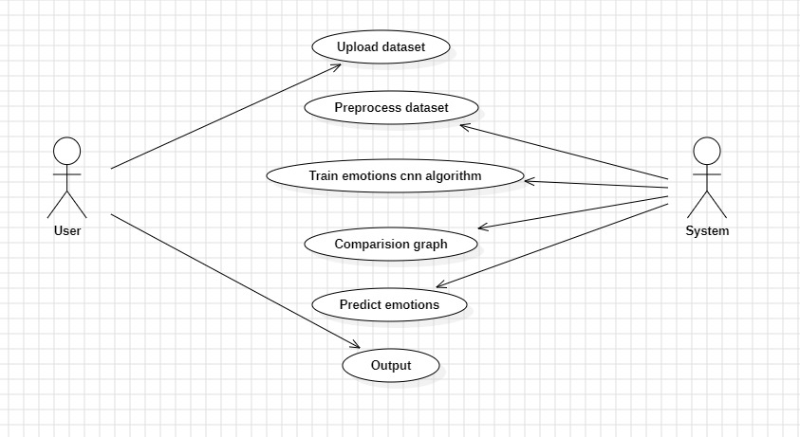
UML DIAGRAMS
USECASE DIAGRAM

Slide 13
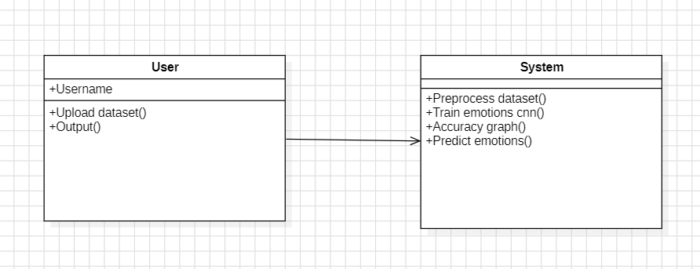
CLASS DIAGRAM

Slide 14
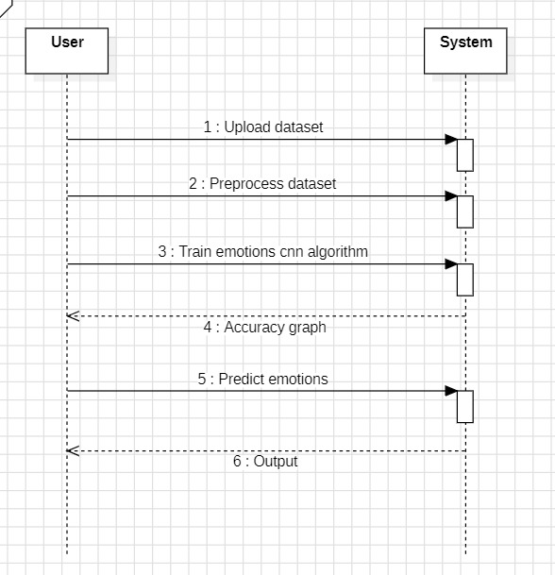
SEQUENCE DIAGRAM

Slide 15
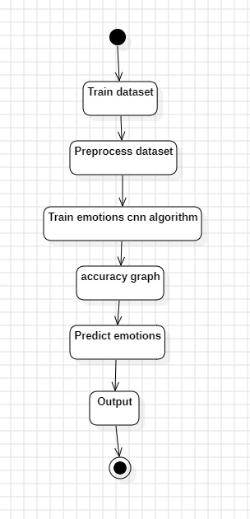
ACTIVITY DIAGRAM

Slide 16
SAMPLE CODE
from tkinter import messagebox
from tkinter import *
from tkinter import simpledialog
import tkinter
import matplotlib.pyplot as plt
import numpy as np
import pandas as pd
from tkinter import simpledialog
from tkinter import filedialog
import os
import cv2
import numpy as np

Slide 17
from keras.utils.np_utils import to_categorical
from keras.layers import MaxPooling2D
from keras.layers import Dense, Dropout, Activation, Flatten
from keras.layers import Convolution2D
from keras.models import Sequential
from keras.models import model_from_json
import pickle
from sklearn.model_selection import train_test_split
import soundfile
import librosa
from vaderSentiment.vaderSentiment import SentimentIntensityAnalyzer

Slide 18
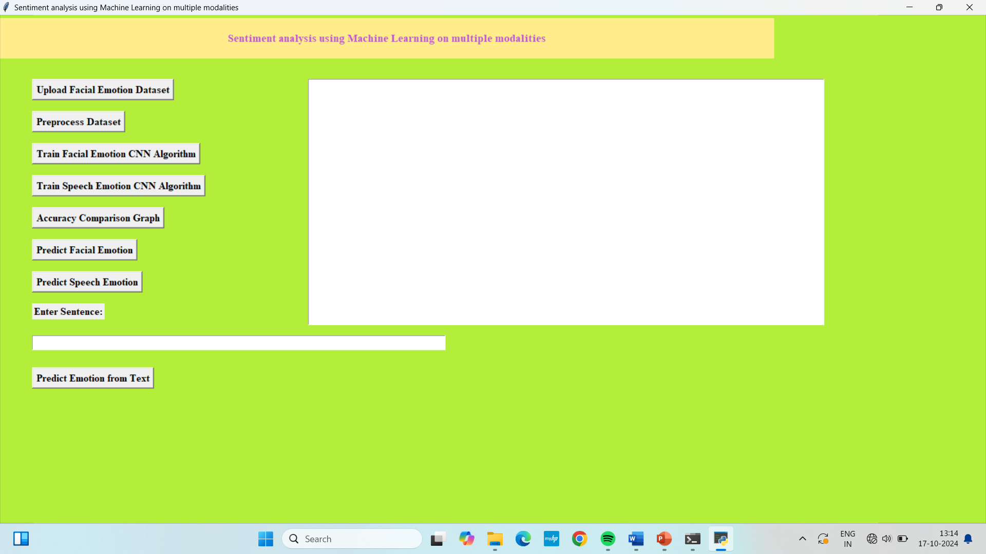
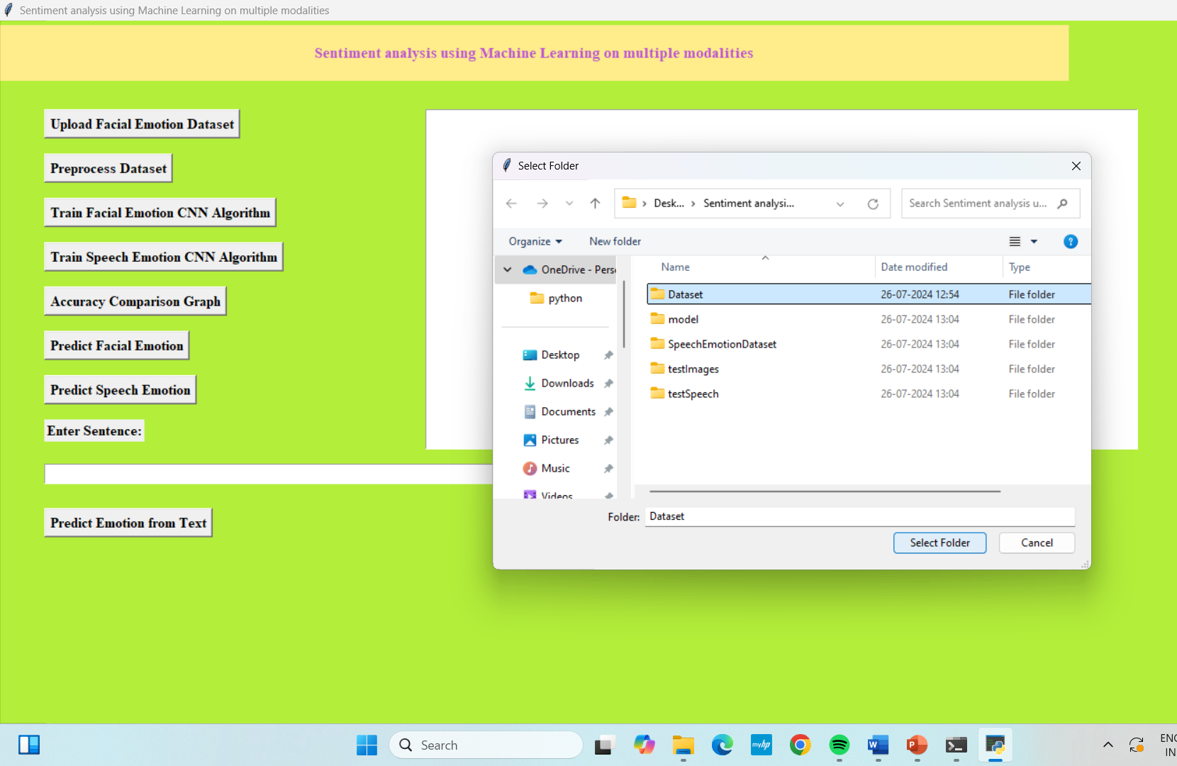
RESULTS HOME PAGE UPLOAD DATASET

Slide 19
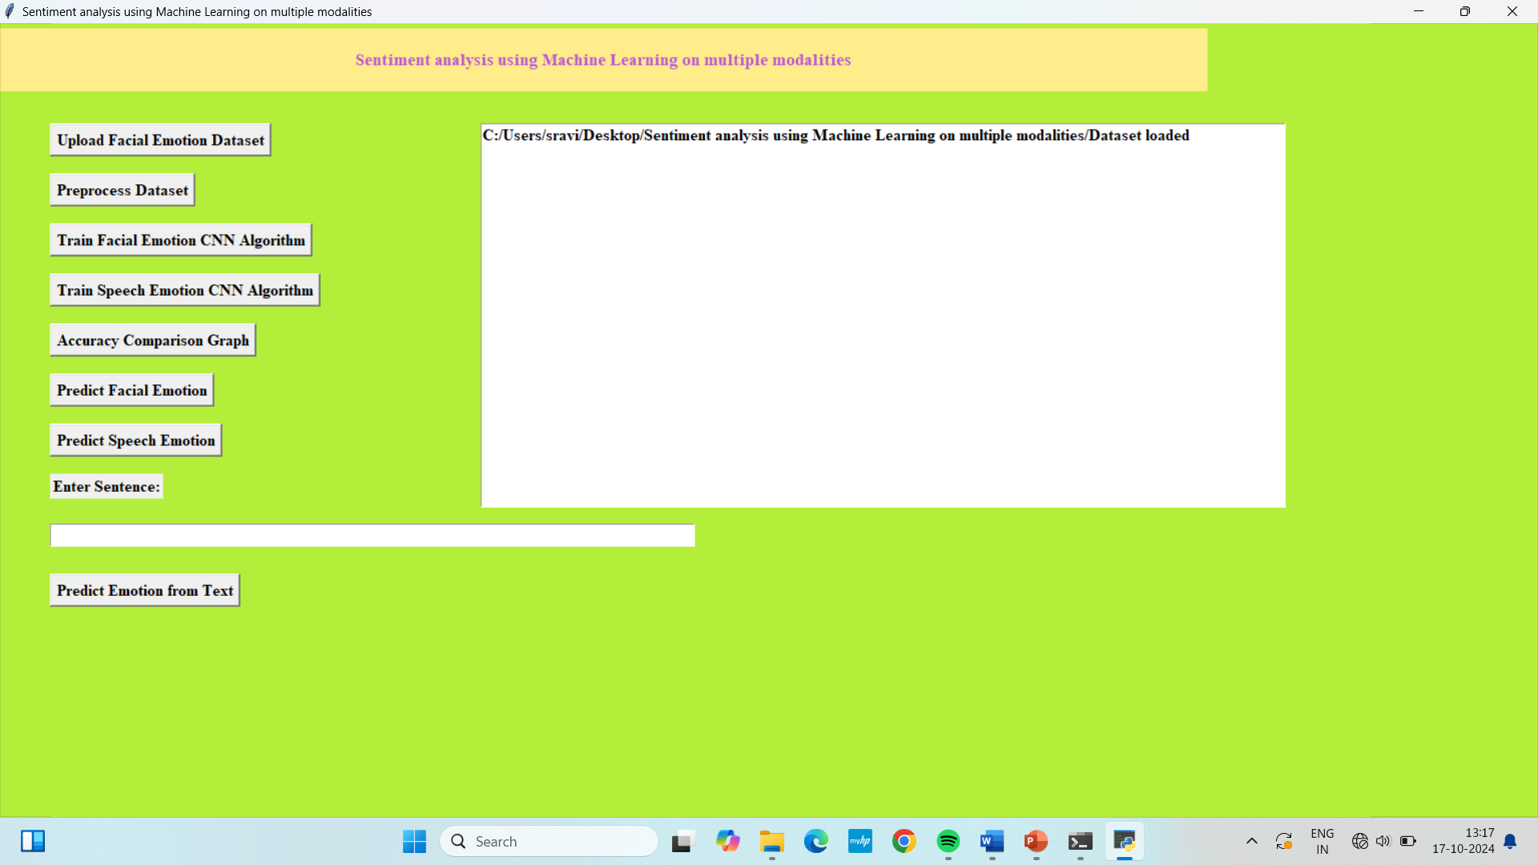
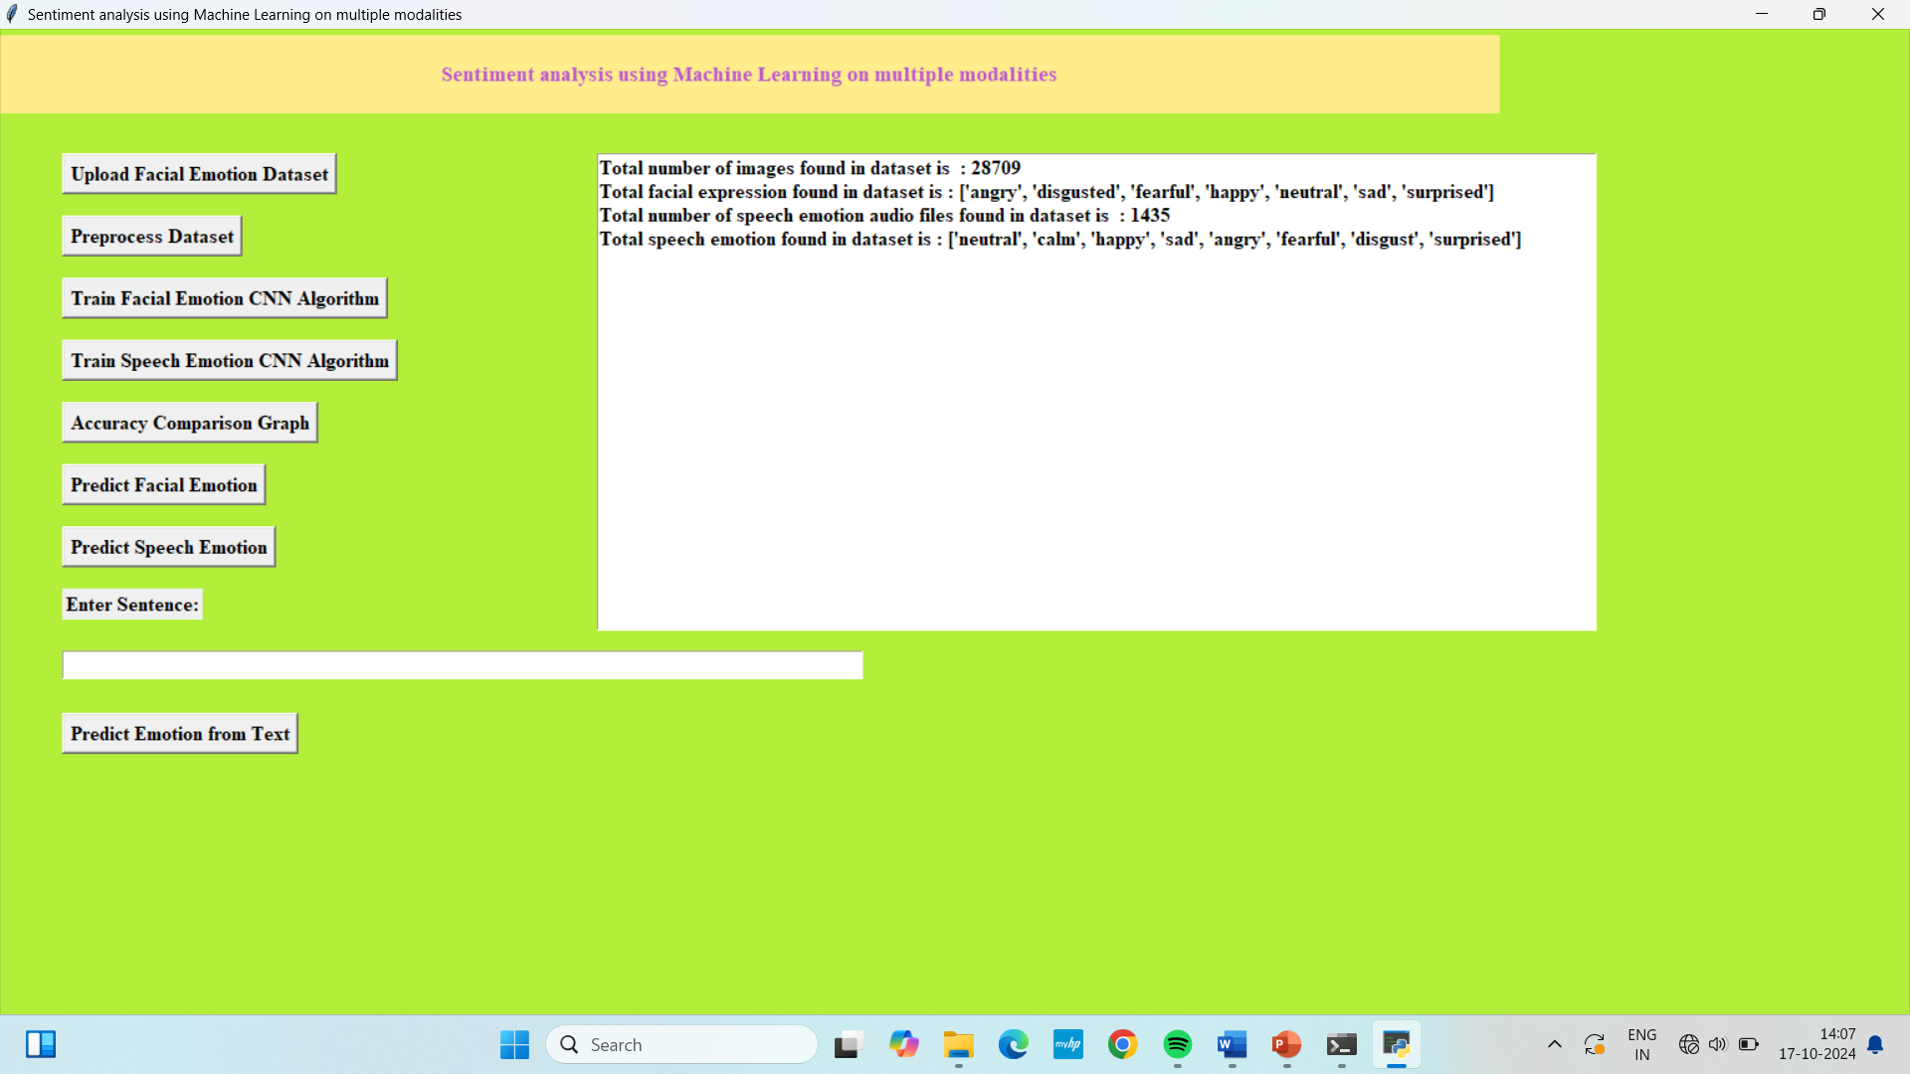
DATASET LOADED PREPROCESS DATASET

Slide 20
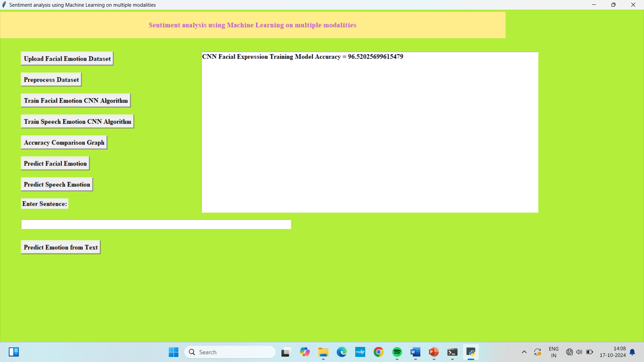

TRAIN FACIAL EMOTION TRAIN SPEECH EMOTION

Slide 21
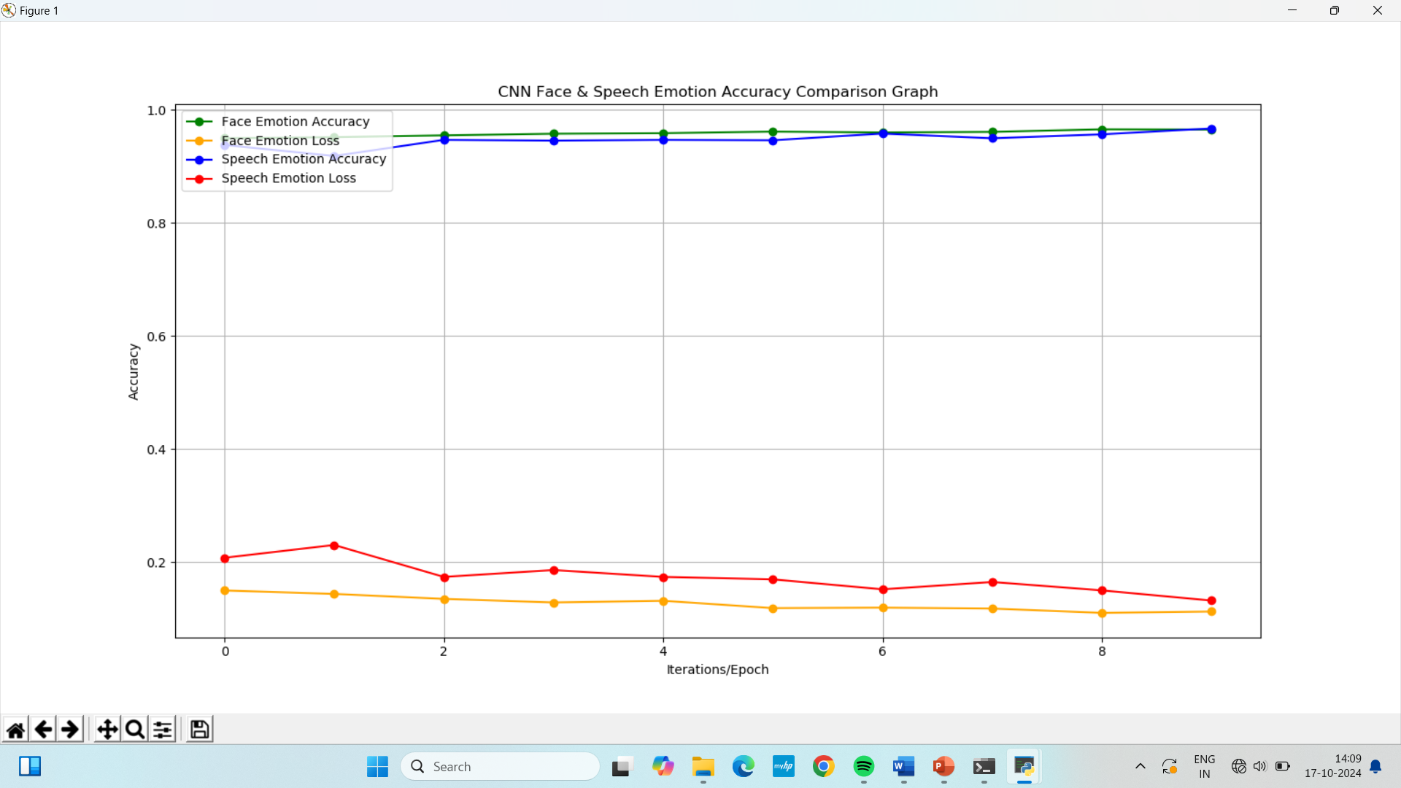
ACCURACY COMPARISION GRAPH

Slide 22
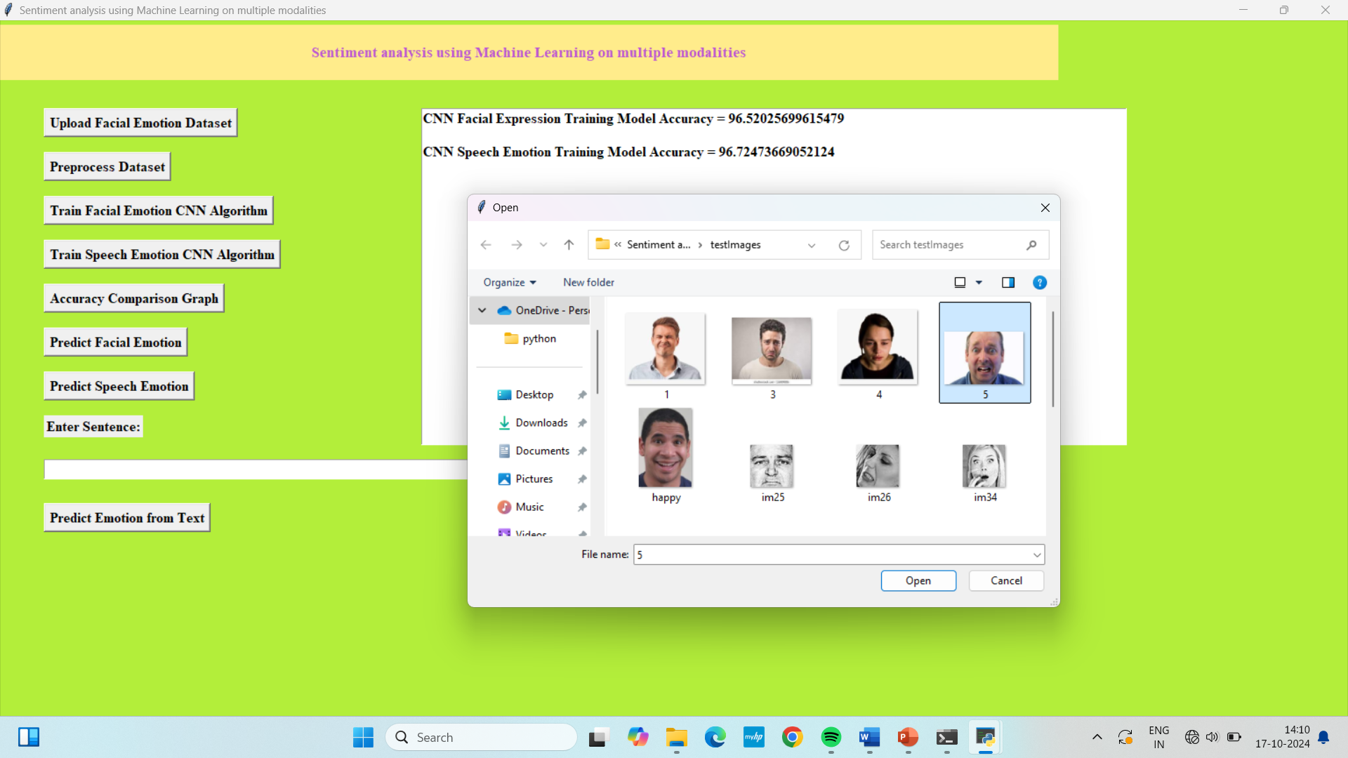
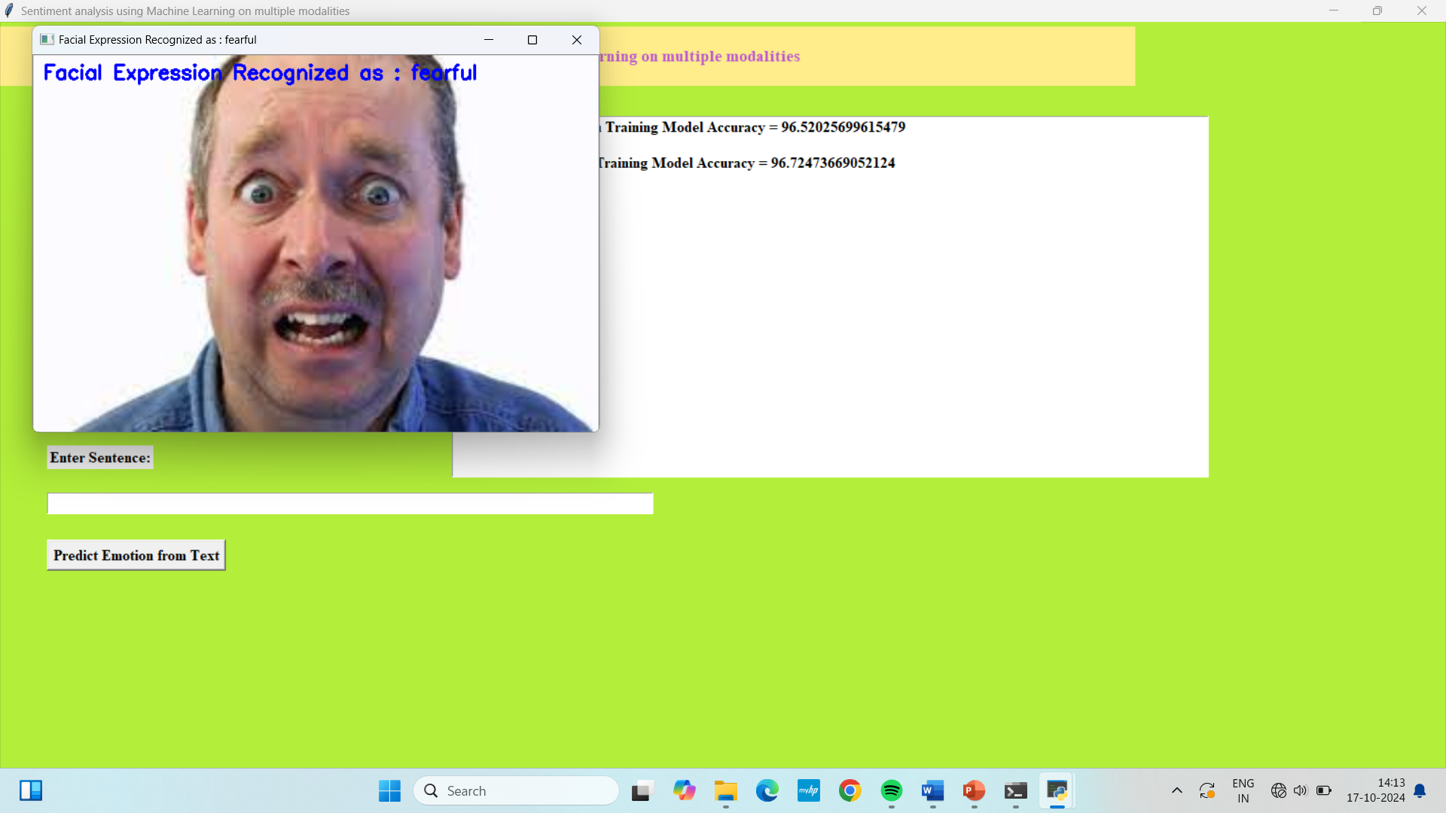
PREDICT FACIAL EMOTION

Slide 23
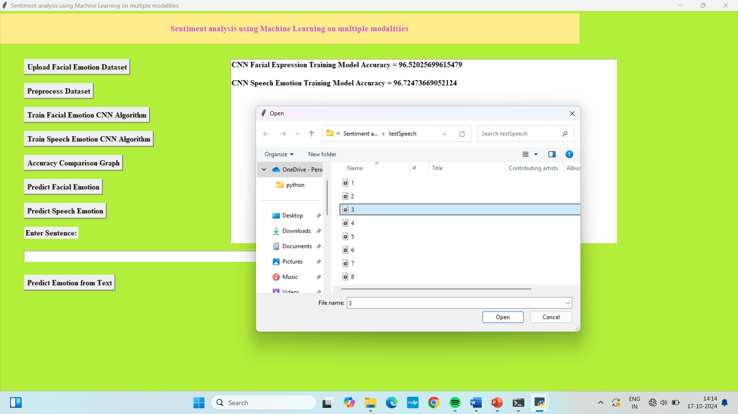
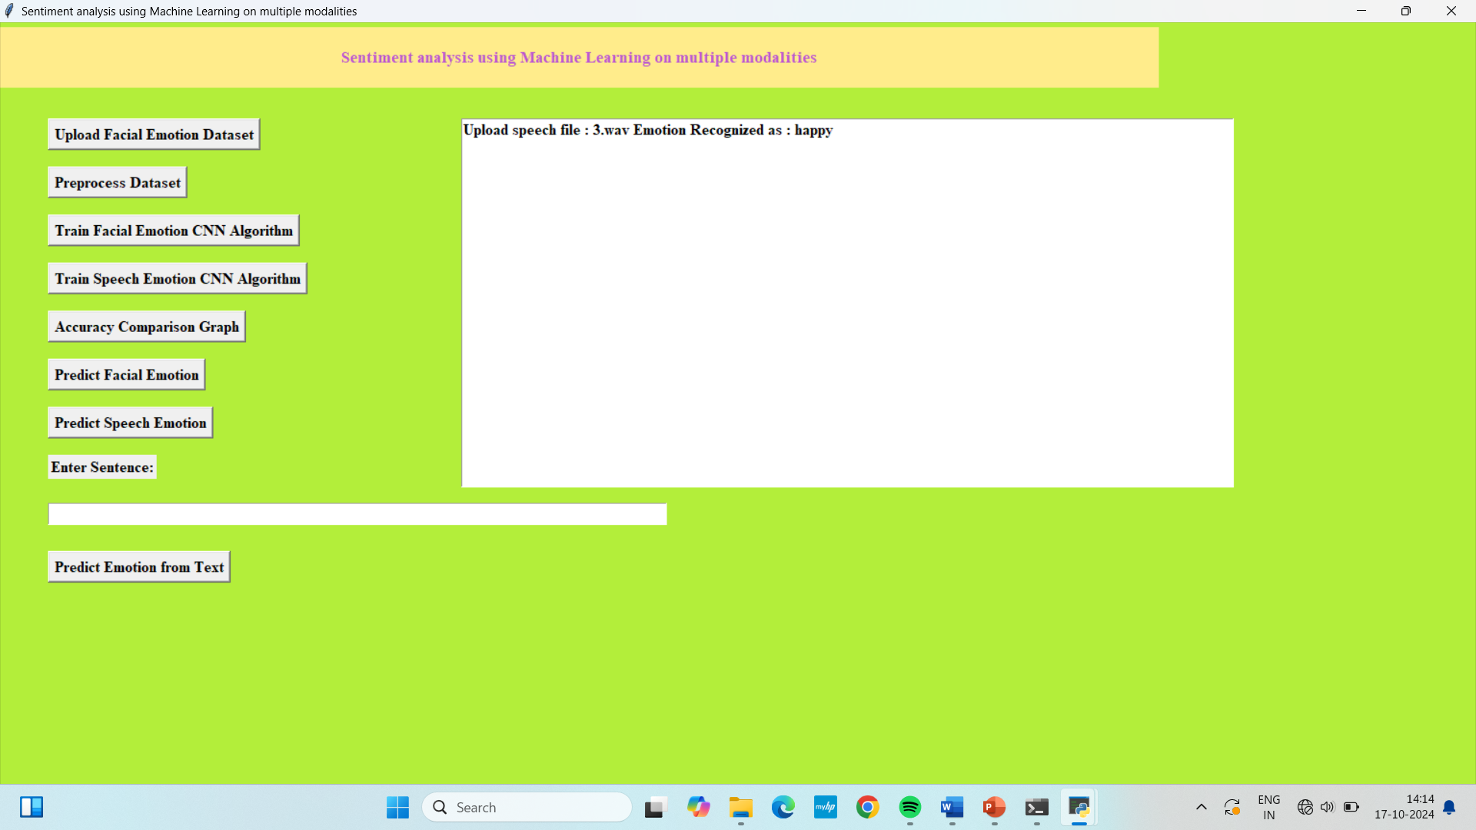
PREDICT SPEECH EMOTION

Slide 24
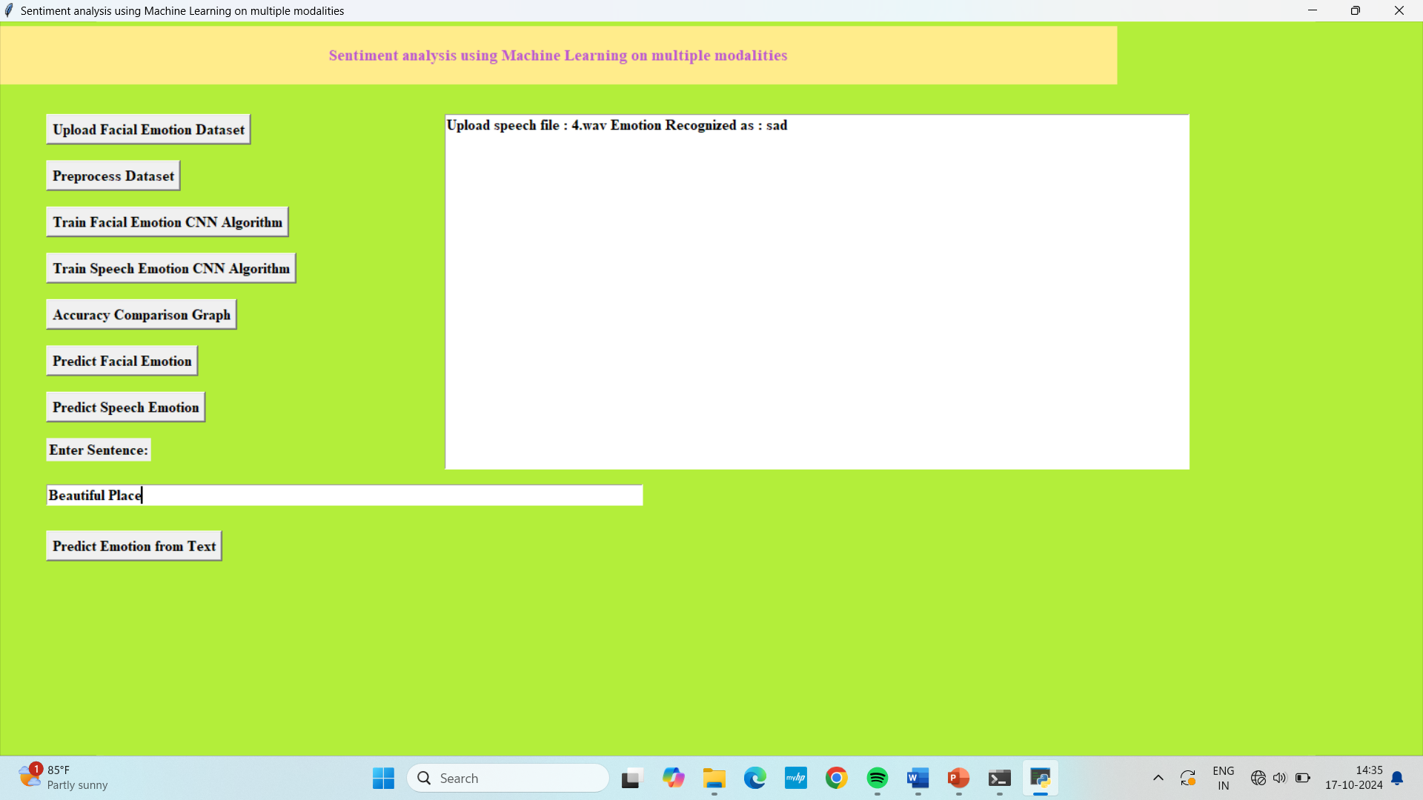
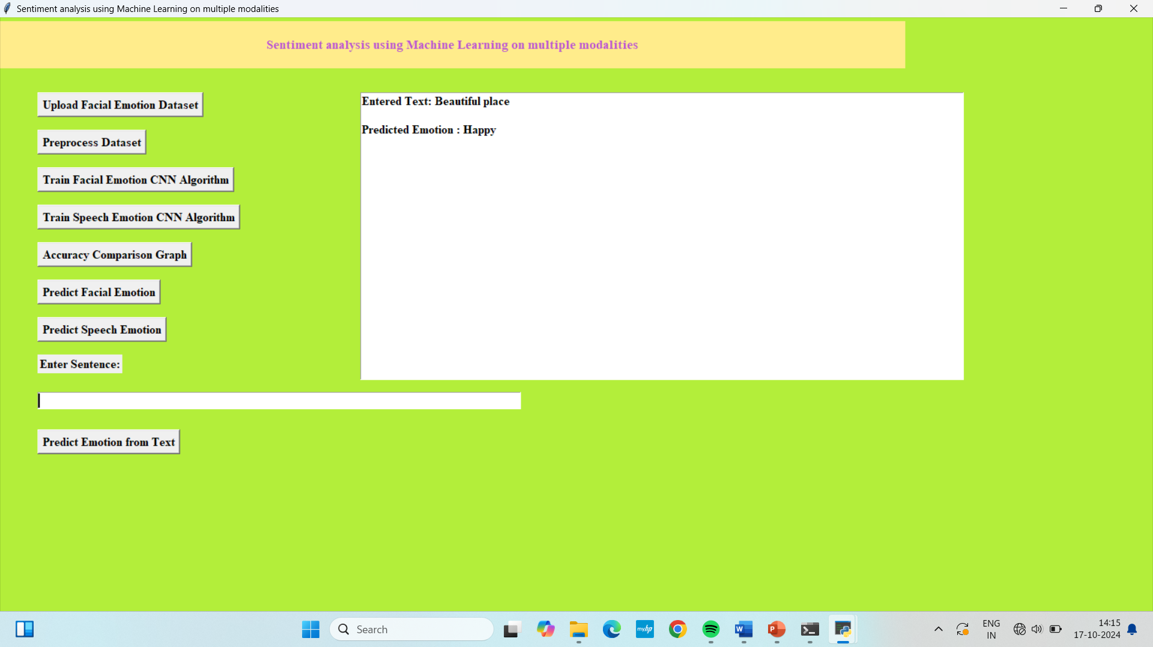
PREDICT EMOTION FROM TEXT

Slide 25
CONCLUSION
In conclusion, the proposed multimodal sentiment analysis system represents a significant advancement in the field by integrating textual, visual, and auditory data to achieve a more nuanced and accurate understanding of sentiment.
By leveraging Convolutional Neural Networks (CNNs), Long Short-Term Memory (LSTM) networks with attention mechanisms, and Recurrent Neural Networks (RNNs), the system capitalizes on the strengths of each modality while addressing their individual limitations.
This comprehensive approach not only improves contextual understanding and robustness against noisy or incomplete data but also broadens the range of applications where sentiment analysis can be applied, including social media, customer feedback, and multimedia content.
The proposed system’s ability to capture complex and subtle emotional cues from multiple sources underscores its potential to advance sentiment analysis and provide deeper insights into human emotions.

Slide 26
FUTURE SCOPE
1. Integration of Additional Modalities:
Video Data: Incorporating video analysis to capture both visual and auditory cues simultaneously, enhancing the depth of sentiment understanding by integrating facial expressions, gestures, and body language.
2. Real-Time Sentiment Analysis:
Scalability: Developing algorithms and infrastructure to enable real-time processing of multimodal data streams, making the system applicable for live social media monitoring, customer service interactions.
3. Application Expansion:
Healthcare and Well-being: Applying the system to monitor and analyse emotional well-being in healthcare settings, providing insights into patient sentiments and mental health.
Entertainment and Media: Enhancing sentiment analysis in entertainment and media by analysing audience reactions to movies, music, and advertisements, enabling better content creation and targeting.

Slide 27
REFERENCES
Zhang, X., Zhao, J., & LeCun, Y. (2015). "Character-level Convolutional Networks for Text Classification." Advances in Neural Information Processing Systems, 649-657.
Link: Character-level Convolutional Networks
Poria, S., Cambria, E., & Hu, B. (2019). "A Survey of Sentiment Analysis in Social Media." Artificial Intelligence Review, 52(2), 689-735.
Link: Sentiment Analysis in Social Media
Hazarika, D., Poria, S., & Cambria, E. (2018). "MISA: Multimodal Sentiment Analysis using Deep Attention." Proceedings of the 27th International Conference on Computational Linguistics (COLING), 1281-1293.
Link: MISA: Multimodal Sentiment Analysis
Wang, X., Li, J., & Li, J. (2020). "Multimodal Sentiment Analysis Using CNNs and RNNs." Journal of Computer Science and Technology (JCST), 35(6), 1094-110
Link: CNNs and RNNs for Multimodal Sentiment Analysis

Slide 28
GITHUB LINK
https://github.com/GangaramSravikaReddy/Sentiment-Analysis-using-Machine-Learning-with-Multiple-Modalities

Slide 29
THANK YOU

